Slide 1
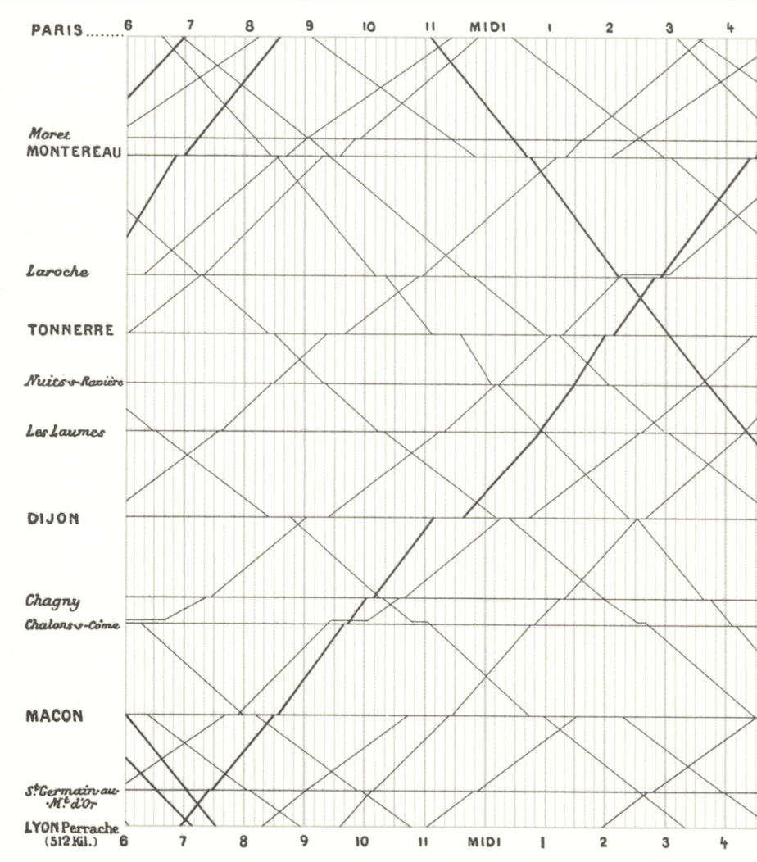
Visualization
as Science 2
A Samuel Pottinger
Stat 198: IDSV
Feb 12, 2025

Slide 2
Today
> Gestalt principles: how we perceive collections of glyphs together.
Group activity: building with gestalt principles.
A closer look at color vision: components of color and perceptually consistent color schemes.

Slide 3
Gestalt principles: introduction
How we pre-attentively perceive glyphs together within scenes.
How we understand how parts form together to build a whole.

Slide 4

Gestalt principles: tour

Slide 5
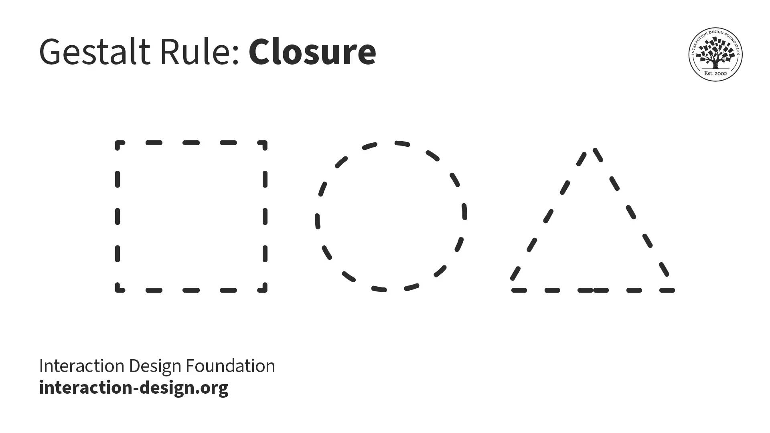
Gestalt principles: tour

Slide 6
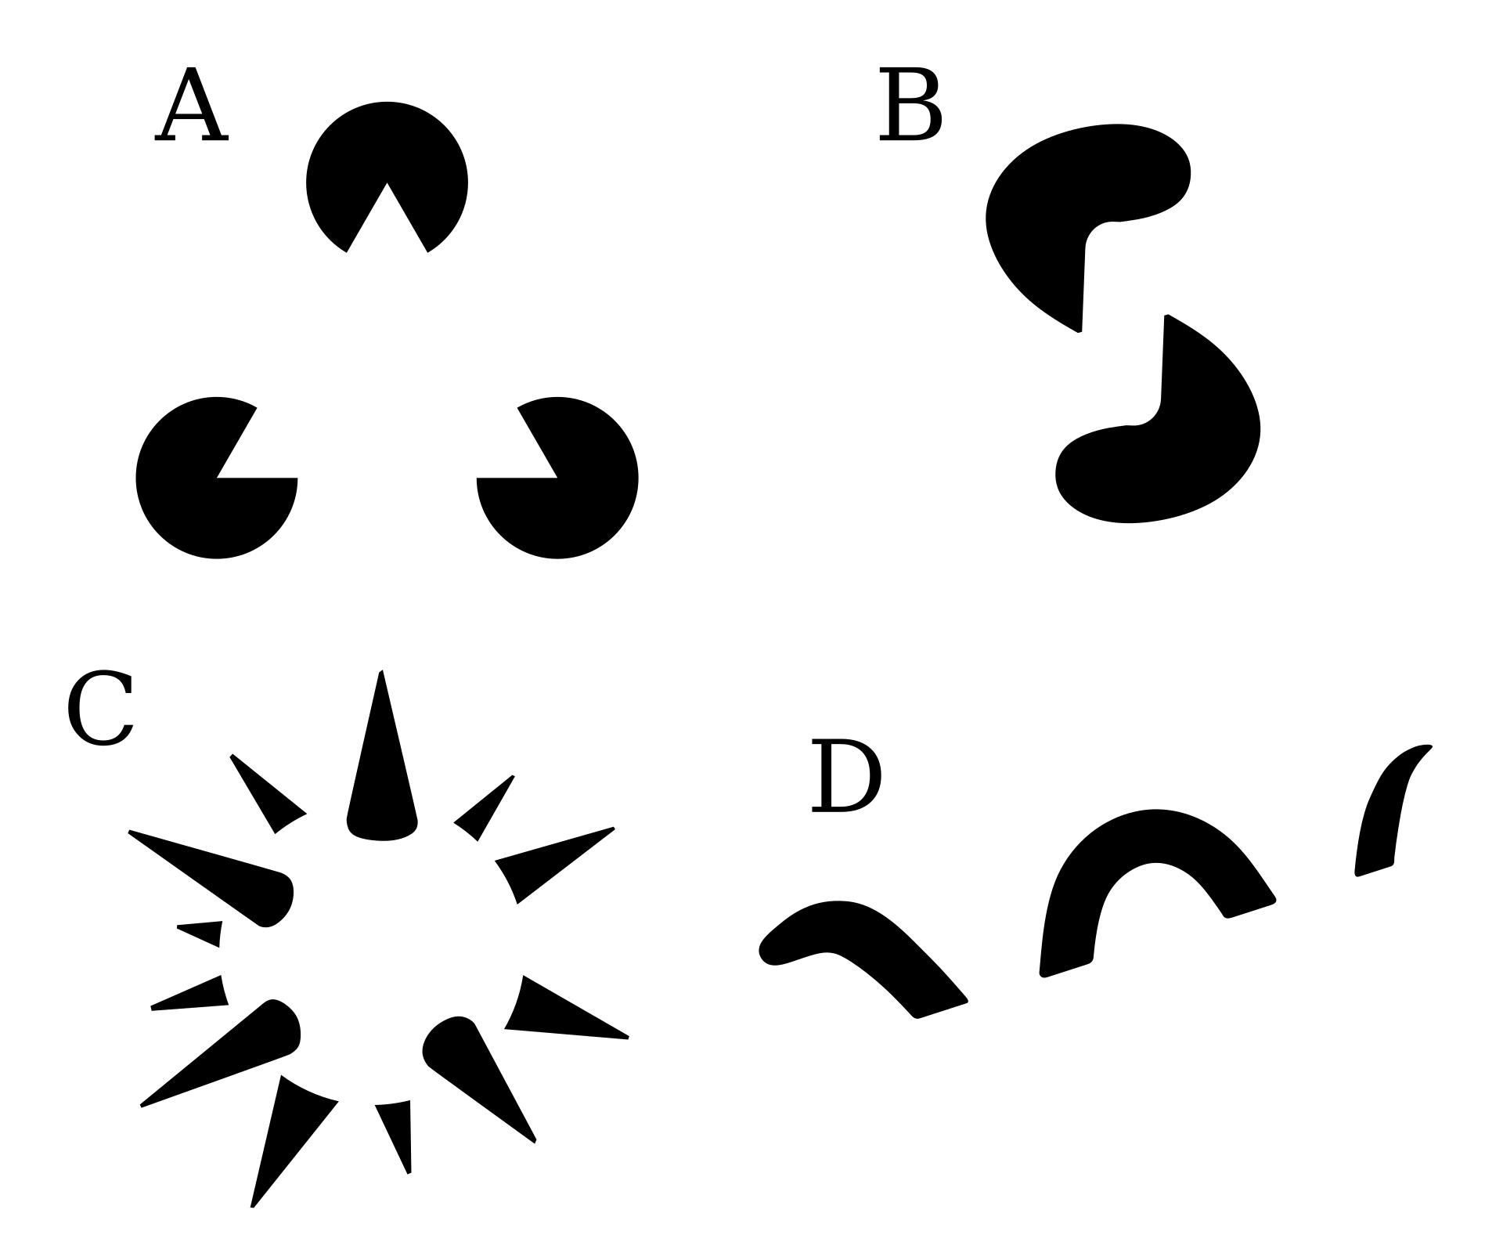
Gestalt principles: tour
“Reification”
Activated “negative space”

Slide 7
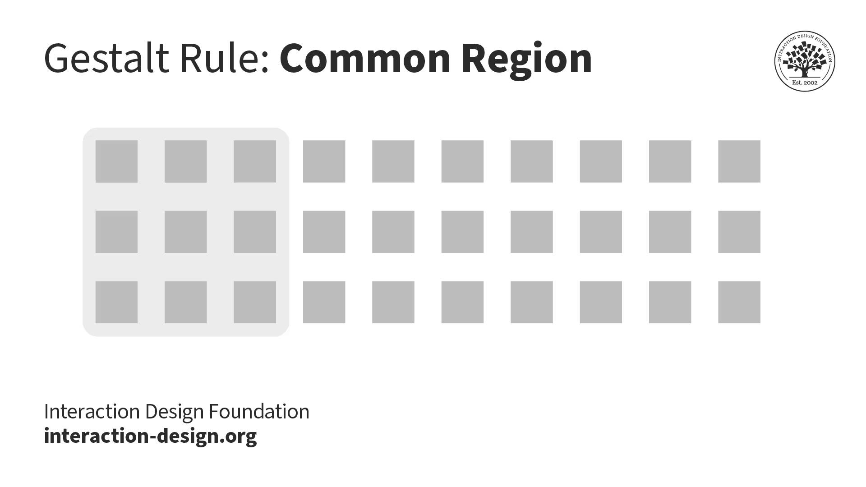
Gestalt principles: tour

Slide 8
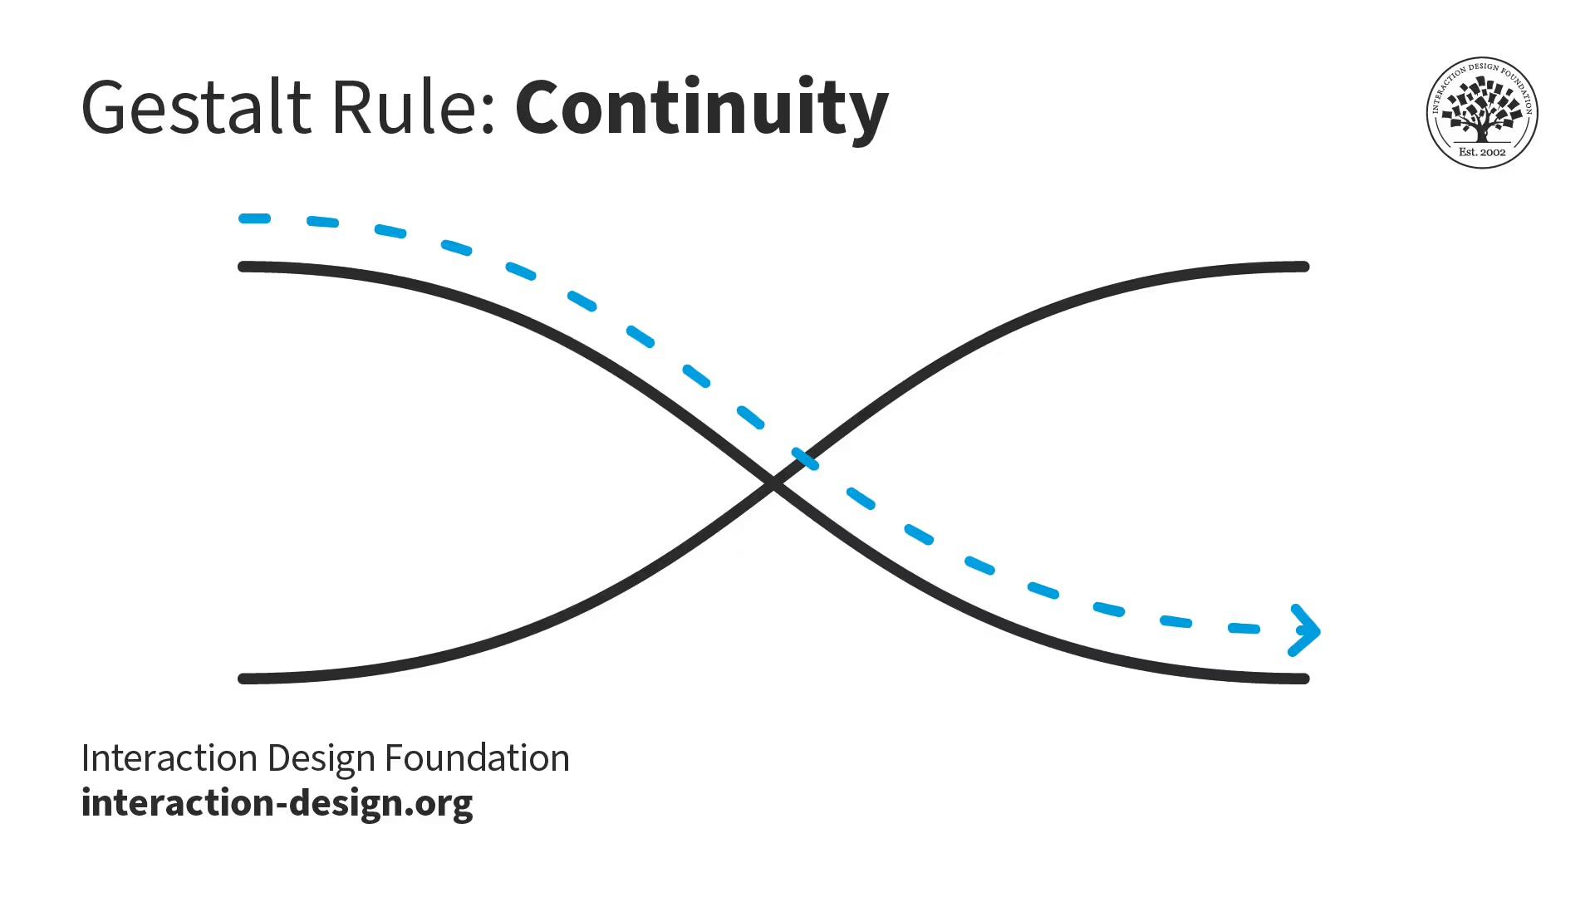
Gestalt principles: tour

Slide 9

Gestalt principles: tour

Slide 10
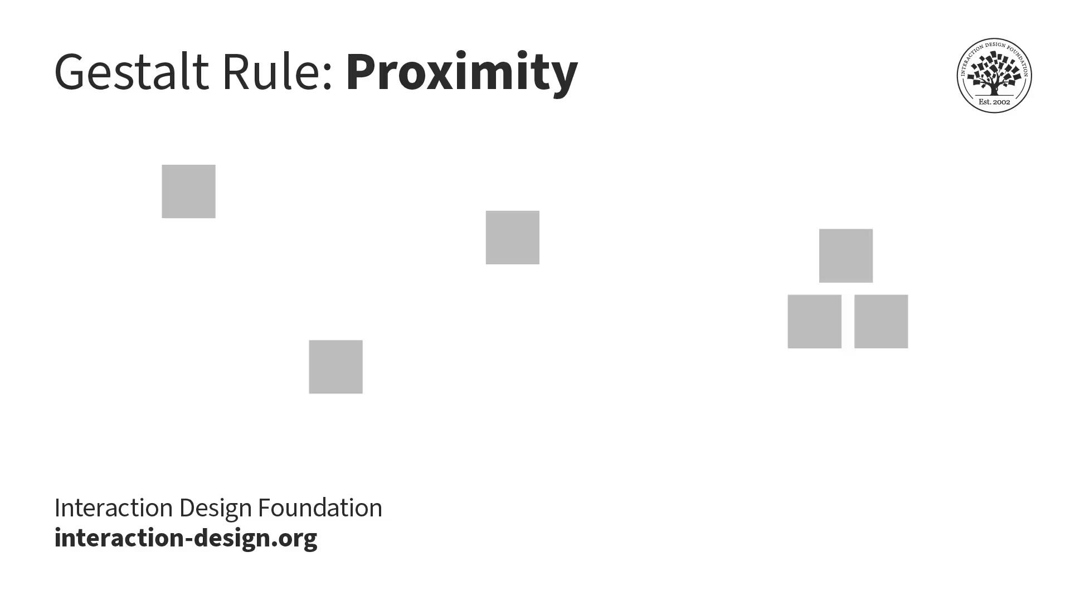
Gestalt principles: tour

Slide 11
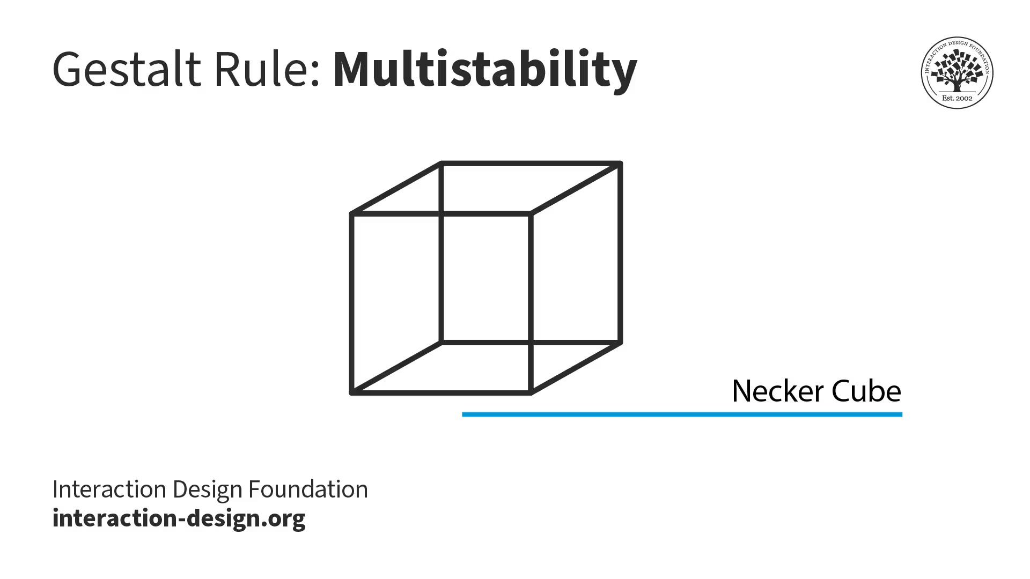
Gestalt principles: tour

Slide 12
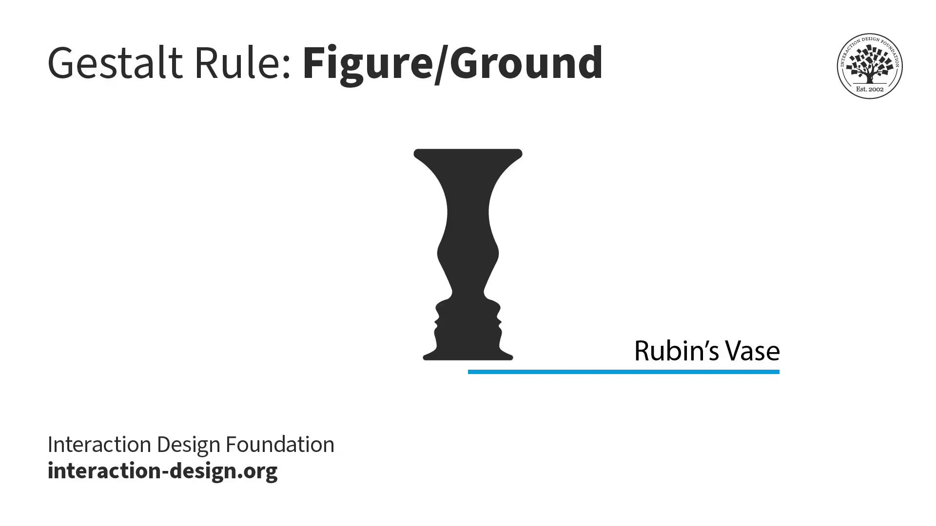
Gestalt principles: tour

Slide 13
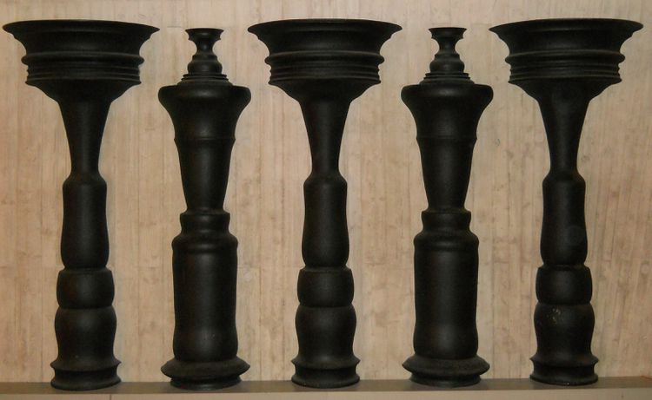
Gestalt principles: tour

Slide 14
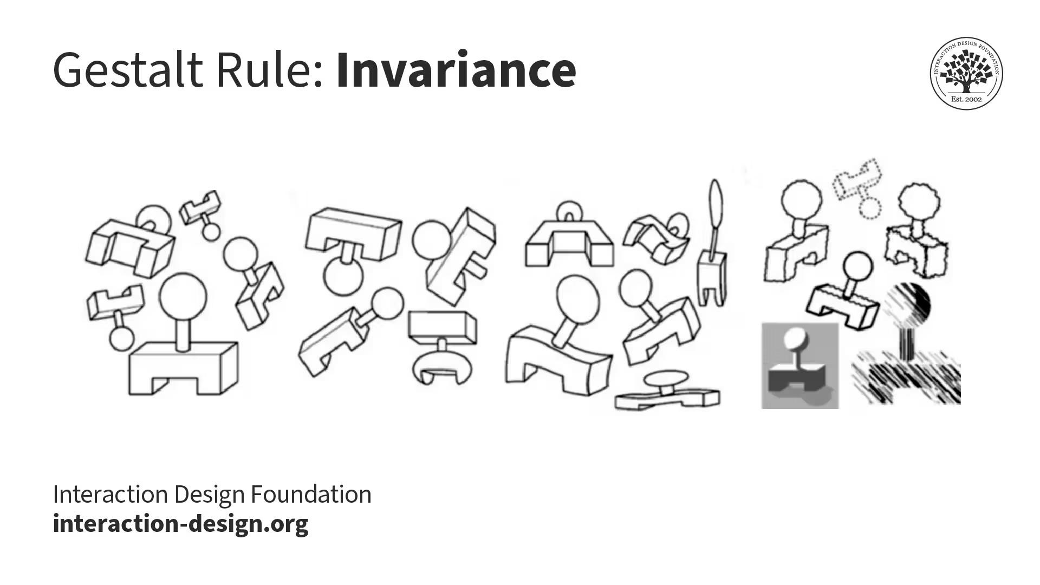
Gestalt principles: tour

Slide 15
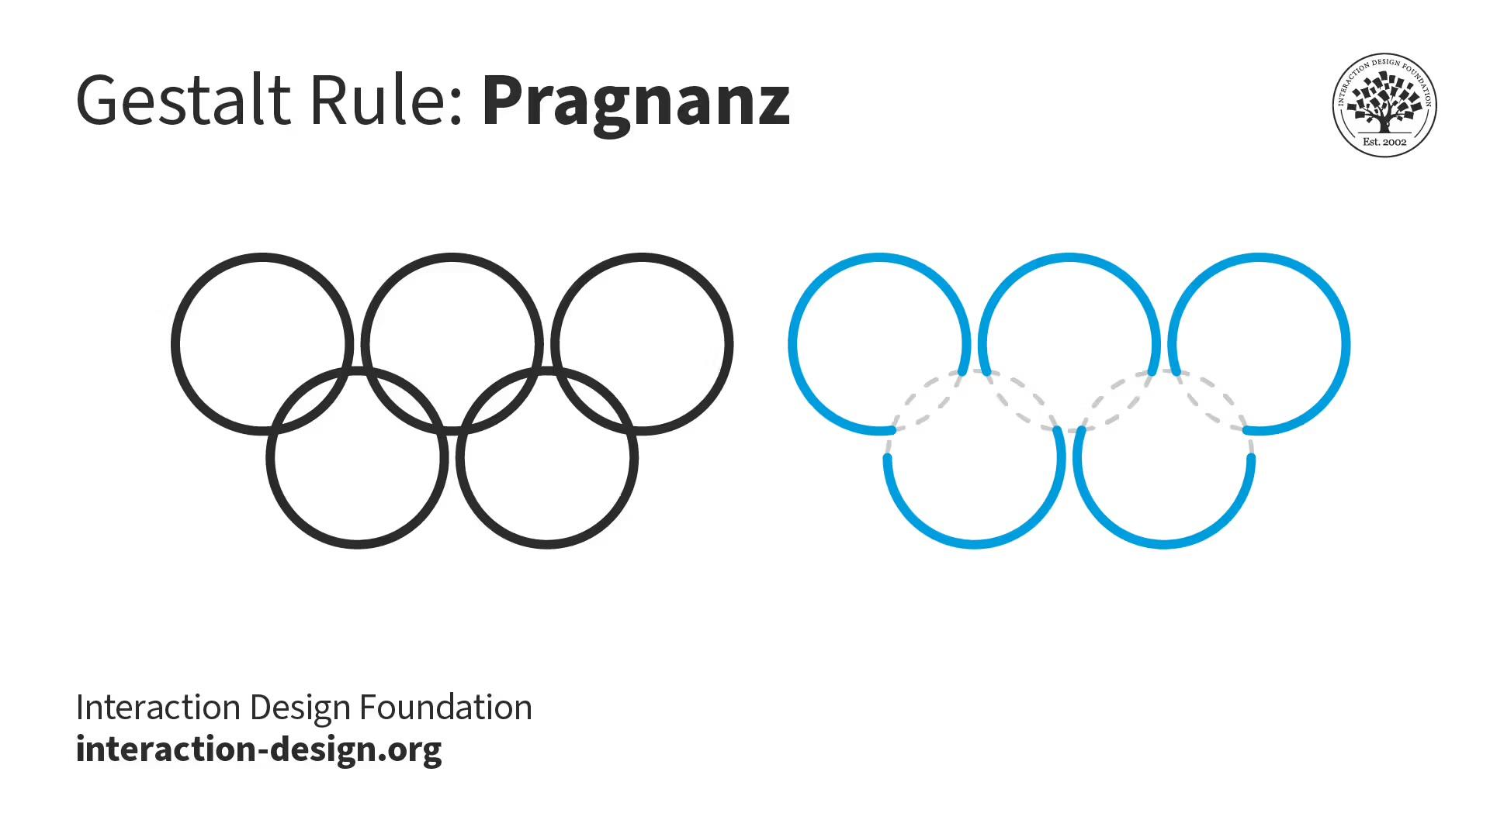
Gestalt principles: tour

Slide 16
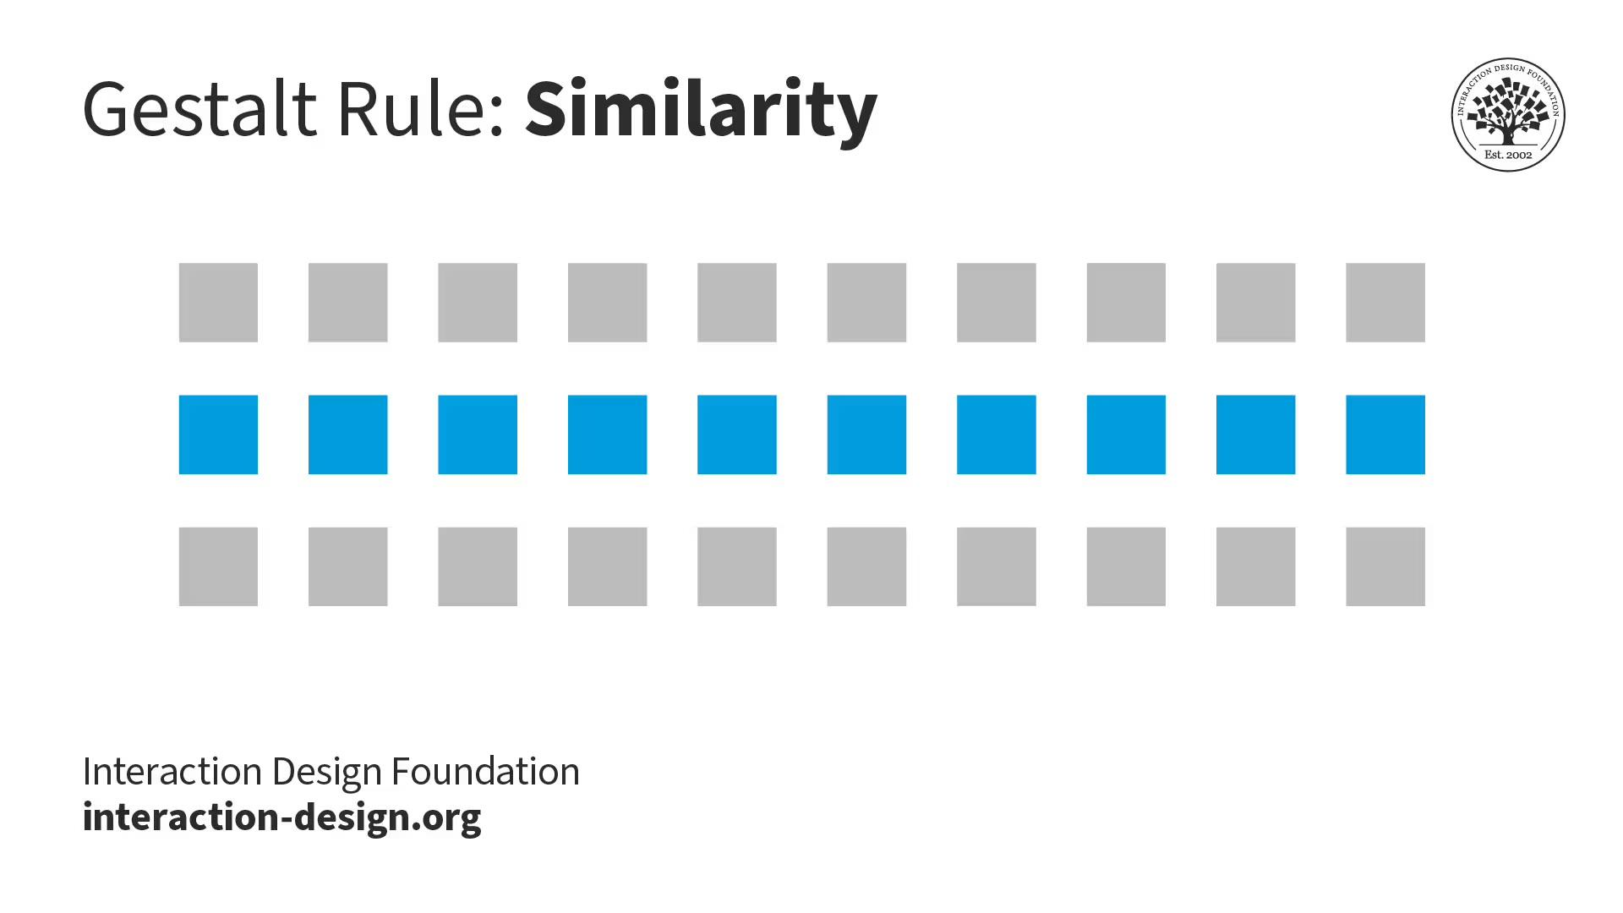
Gestalt principles: tour

Slide 17
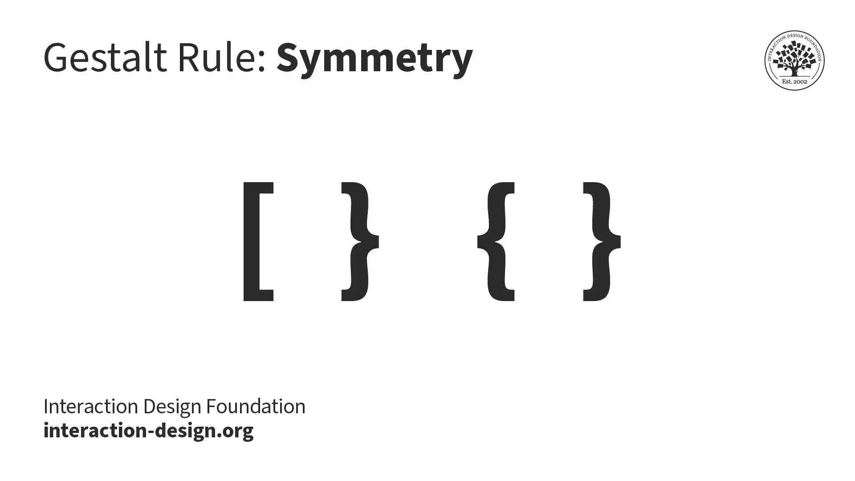
Gestalt principles: tour

Slide 18
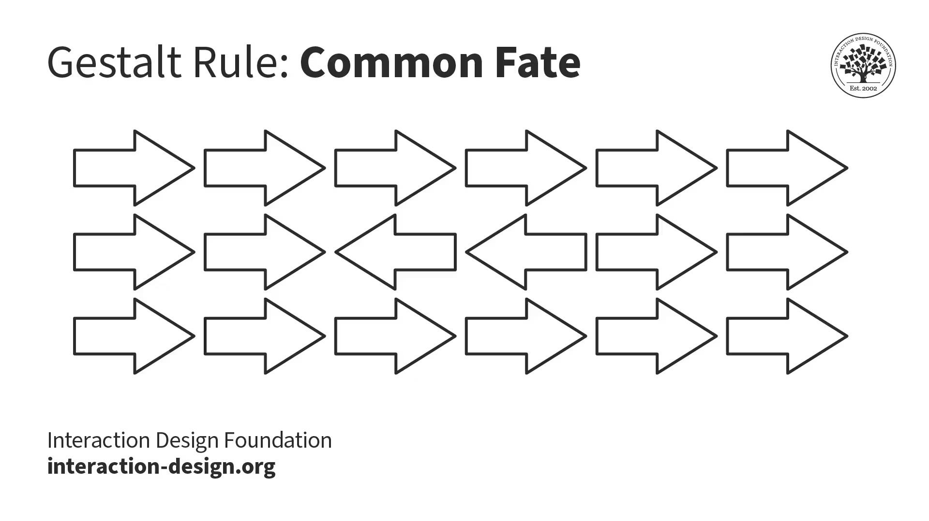
Gestalt principles: tour

Slide 19
Gestalt principles: why
These principles tell us how to create “hierarchy” within our work. This lets us combine glyphs together to make larger structures.

Slide 20
Today
Gestalt principles: how we perceive collections of glyphs together.
> Group activity: building with gestalt principles.
A closer look at color vision: components of color and perceptually consistent color schemes.

Slide 21
Gestalt principles: activity
Use these blocks to build the following:
Proximity
Continuity
Similarity
Symmetry
Closure
For volunteers, we will screenshot and put into Zulip.

Slide 22
Today
Gestalt principles: how we perceive collections of glyphs together.
Group activity: building with gestalt principles.
> A closer look at color vision: components of color and perceptually consistent color schemes.

Slide 23
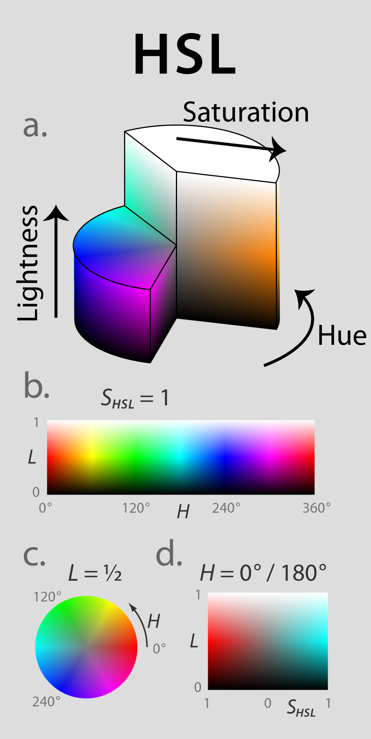
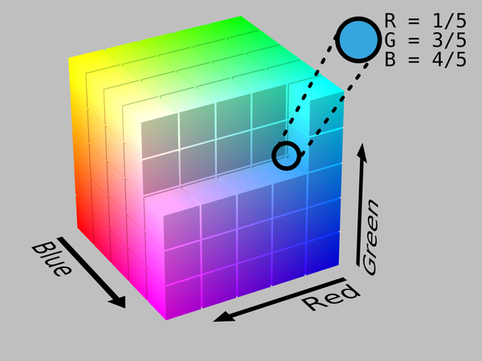
Color spaces: examples

Slide 24
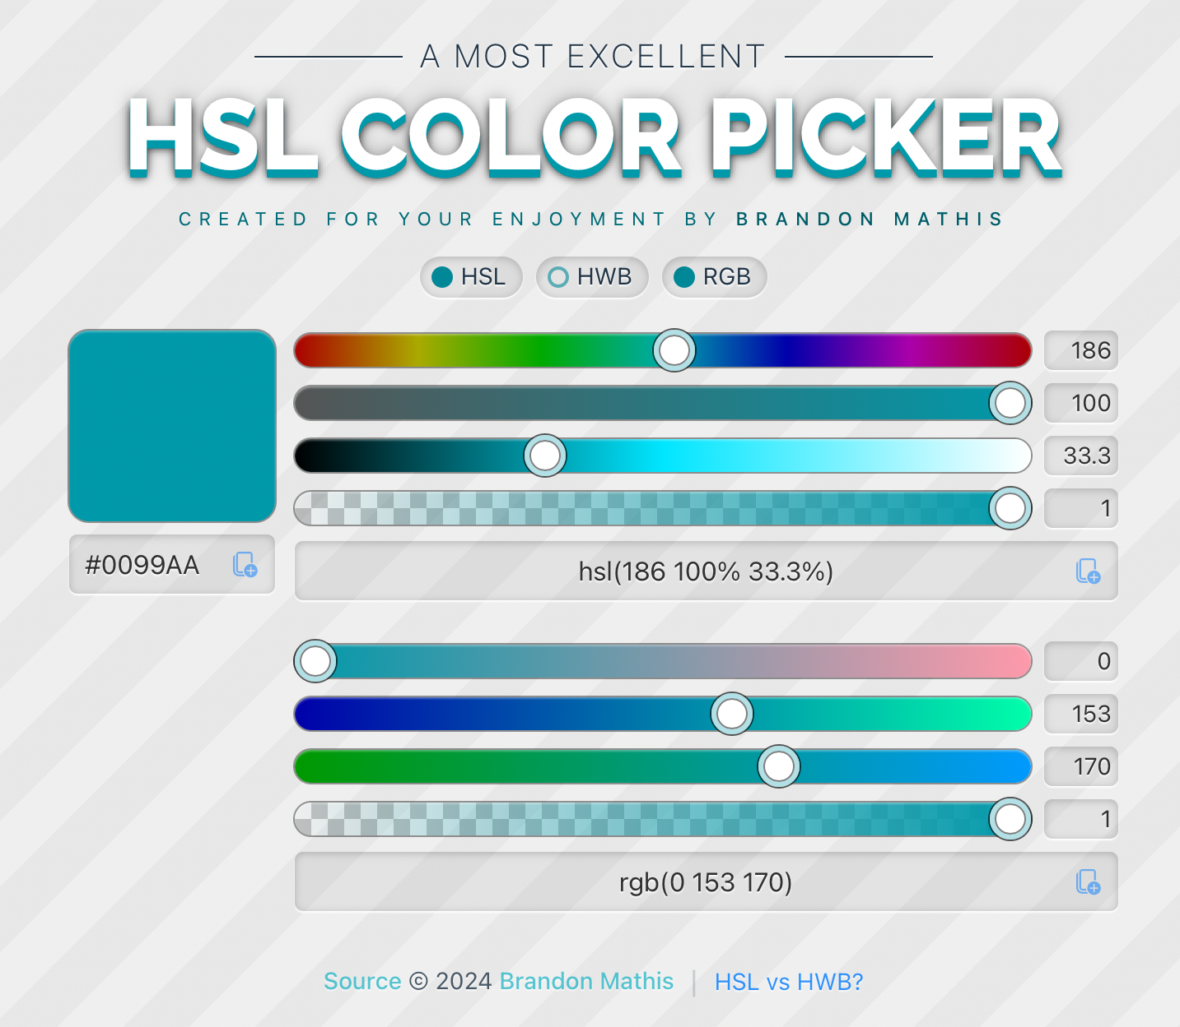
Color spaces: examples
RGB is what most code will work with. Some folks might recognize hex codes. This is what computers typically use to represent colors.
HSL is sometimes useful for building color schemes. For example, creating a shadow often involves decreasing luminance and saturation.

Slide 25

Color spaces: examples
RGB is what most code will work with. Some folks might recognize hex codes. This is what computers typically use to represent colors.
HSL is sometimes useful for building color schemes. For example, creating a shadow often involves decreasing luminance and saturation.

Slide 26
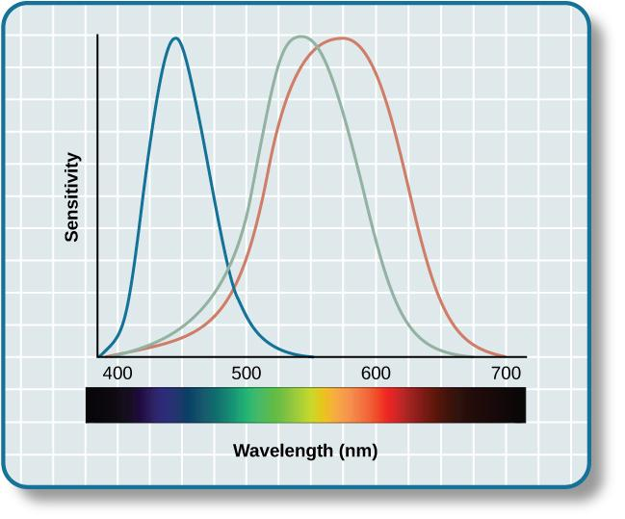
Color: reminder about sensitivities

Slide 27
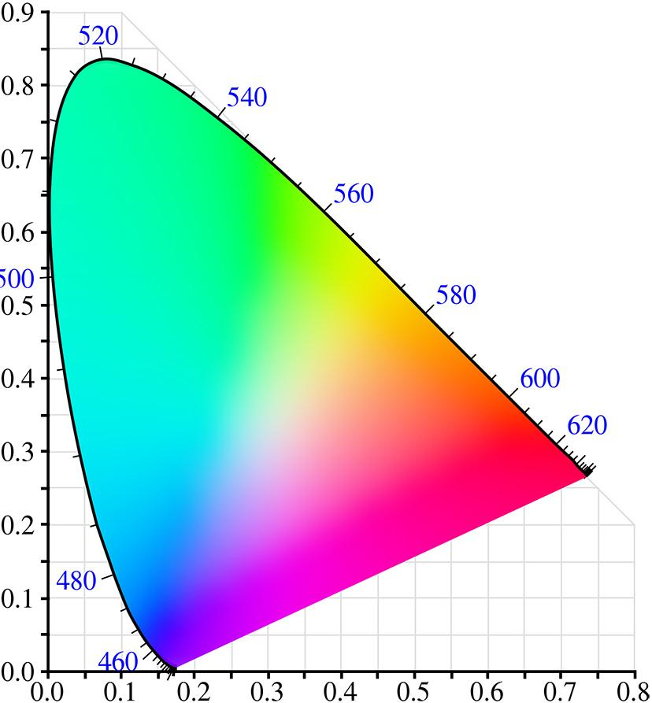


Color spaces: perceptual consistency
CIE chromaticity diagram

Slide 28
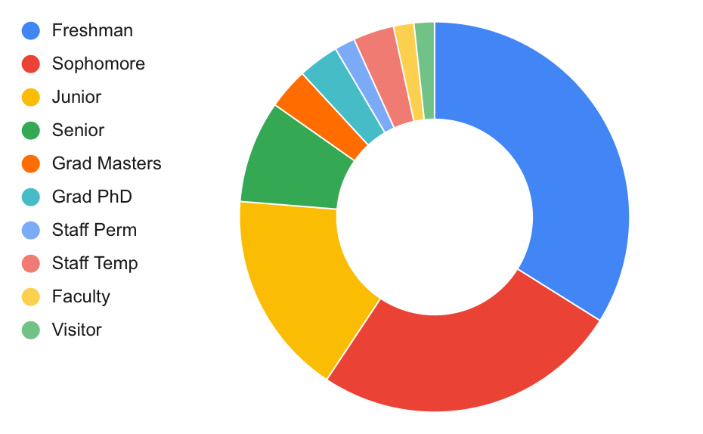
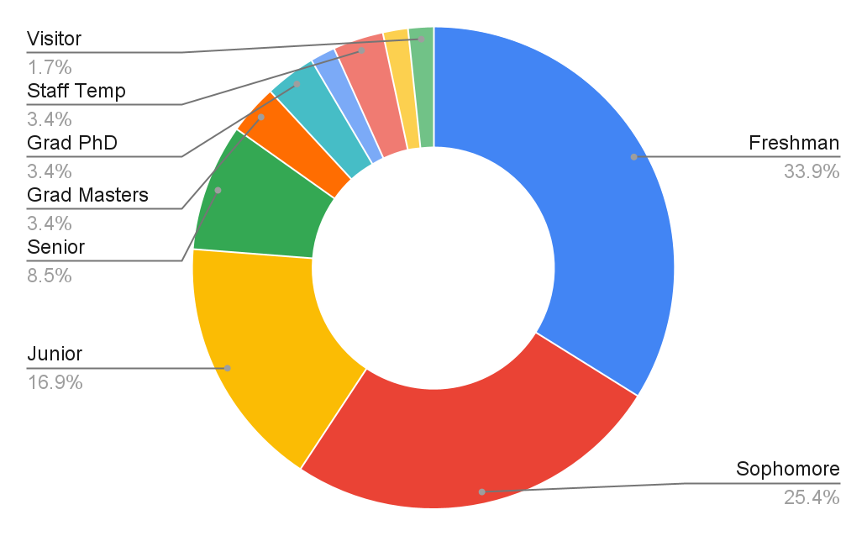
Color spaces: other trickery
Remember that color is contextual. It depends on the background and can be influenced by glyphs nearby.
For quantitative scales: depending on the size of the glyph, we might focus more on luminance so consider keeping other values consistent.
For qualitative scales: We only get about a max of 6 colors reliably.
If you can double encode or direct label instead.

Slide 29
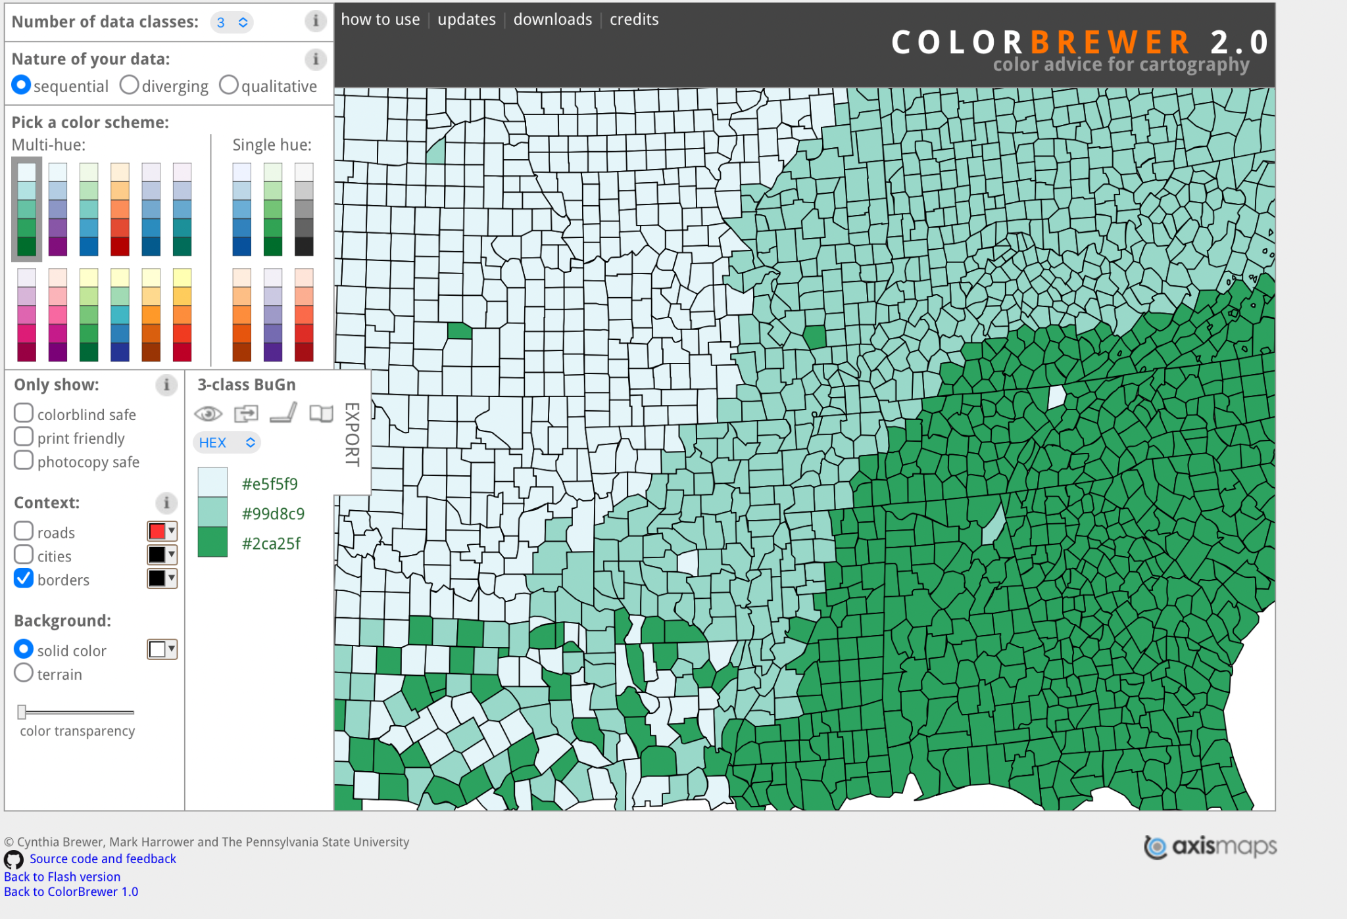
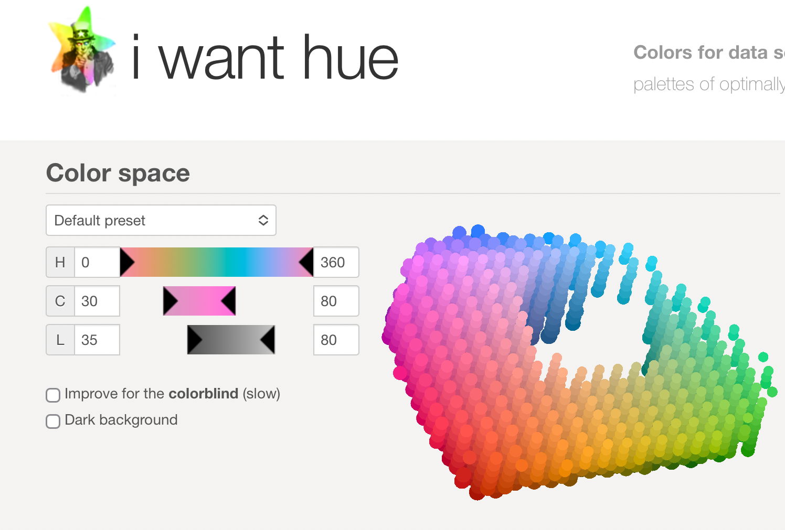
Color spaces: tools
Creating these schemes can be a bit involved, especially considering color blindness. Starting with ColorBrewer followed by I Want Hue is a good move.

Slide 30
Color: general recommendations
We are going to come back to color-blind users later.
Consider not using color as an encoding device and, instead, leave it for aesthetic and branding.
If color is needed for quantitative scales, consider just using luminance. Color can be used for other reasons. Try using a scheme generator like ColorBrewer.
If you have to use color as a qualitative encoding, use ColorBrewer or I Want Hue. Remember we only get about 6 colors reliably. An alternative is direct labeling.
When possible, double encode so the graphic still works without color.

Slide 31
What we did today
Gestalt principles: how we perceive collections of glyphs together.
Group activity: building with gestalt principles.
A closer look at color vision: components of color and perceptually consistent color schemes.

Slide 32
Classroom reminders
Please add a profile picture on Zulip (if comfortable). I’m trying to learn more names!
Exercises 5 and 6 are tied together. Be sure to complete both soon!
Office hours on Friday at 3pm. See Zulip.

Slide 33
Works cited
B. Adhikari, "Marey's train schedule," University of Missouri Saint Louis, 2021. Available: https://badriadhikari.github.io/data-viz-workshop-2021/minards/
C. Ware, “Information Visualization: Perception for Design,” MK Press.
C. Ware, “Visual Thinking for Design,” MK Press.
Interaction Design Foundation - IxDF. “What are the Gestalt Principles?” Interaction Design Foundation - IxDF. Available: https://www.interaction-design.org/literature/topics/gestalt-principles (accessed Feb. 12, 2025).
MRMW, “Reification,” Wikimedia, 2020. Available: https://en.wikipedia.org/wiki/Gestalt_psychology#/media/File:Reification.svg
B. Young, “Cross Keys,” Wikimedia, 2011. Available: https://en.wikipedia.org/wiki/Gestalt_psychology#/media/File:CrossKeys.png.
“Vision,” CourseHero. Available: https://www.coursehero.com/study-guides/wmopen-psychology/outcome-vision/
R. Madsen, “Perceptually uniform color spaces,” Programming Design Systems, 2020. Available: https://programmingdesignsystems.com/color/perceptually-uniform-color-spaces/
SharkD, “RGB Cube,” Wikimedia, 2010. Available: https://en.wikipedia.org/wiki/RGB_color_spaces#/media/File:RGB_Cube_Show_lowgamma_cutout_b.png.
J. Rus, “HSL and HSV Models,” Wikimedia, 2010. Available: https://en.wikipedia.org/wiki/RGB_color_spaces#/media/File:RGB_Cube_Show_lowgamma_cutout_b.png.
K. Cherry, “Figure / Ground Perception in Psychology,” Verywell Mind, 2023. Available: https://www.verywellmind.com/what-is-figure-ground-perception-2795195.
C. Brewer, M Harrower, and The Pennsylvania State University, “Colorbrewer 2.0,” The Pennsylvania State University, 2013. Available: https://colorbrewer2.org/.
M. Jacomy, “I Want Hue,” Sciences-Po Medialab, 2024. Available: https://medialab.github.io/iwanthue/.
B. Mathis “HSL Color Picker,” 2024. Available: https://hslpicker.com/#ffd900

Slide 34


